Slide 1
PROFESSIONAL ETHICS (HUT 200)
Module 1
Human Values

Slide 2
Syllabus
Morals, values and Ethics – Integrity- Academic Integrity-Work Ethics- Service Learning- Civic Virtue-Respect for others- Living peacefully- Caring and Sharing- Honestly- Courage-Cooperation Commitment-Empathy-Self Confidence -Social Expectations.

Slide 3
Introduction
VALERE → VALUE
To be of worth (Latin)
Worth, desirability or utility of a thing (Oxford Dictionary).
Something which are desirable and worthy of esteem for their own sake.
Human Values – those values which help man to live in harmony with the world
Love, brotherhood, respect of others, honesty, sincerity, truthfulness, non-violence, gratitude, tolerance, sense of responsibility, cooperation, self-reliance, secularism, internationalism etc.

Slide 4
Continued..
Values are the basis of human personality and are a very powerful but silent force affecting human behaviour.
The values are the attributes possessed by an individual.
More permanent and well built in nature.
An understanding of the values becomes a necessity in every parts of human life.

Slide 5
Sources of Values
Family Factor
Social Factors
Personal Factors
Cultural Factors
Religious Factors
Life Experiences
Role Demands
Halo Effect

Slide 6
Types of Values
Ultimate Values
Represent the beliefs that affect our decision on how to live.
Democratic Values
A procedural notion
Educational Values
Impact of knowledge
Subjective (Or Internal) Values
Objective (Or External) Values
Instrumental
Intrinsic Values
Aspects show or represent the Values taken for granted from four different angles:
Life Perspectives
Individual
Society
Natural World

Slide 7
Morals
Morals are the prevailing standards of behavior that enable people to live cooperatively in groups.
Moral refers to what societies sanction as right and acceptable.
Morality often requires that people sacrifice their own short-term interests for the benefit of society.
People or entities that are indifferent to right and wrong are considered amoral,
Those who do evil acts are considered immoral.

Slide 8
Continued
Morality is not fixed.
Morality describes the particular values of a specific group at a specific point in time.
Morals are the principles that guide individual conduct within society.
While morals may change over time, they remain the standards of behavior that we use to judge right and wrong.

Slide 9
Ethics
The meaning of ethic is a “system of moral principles, rules and conduct.” (Oxford Dictionary)
Ethics is a “science of morals.”
The words ethics has emerged from Latin ‘Ethicus’ or in Greek ‘Ethicos’.
The beliefs what is right, what is fair and what is proper are our moral standards.
Any action can be termed good or right or bad or wrong are relative and moral judgments.
The problem has one more side that who is making the judgment.

Slide 10
Importance of Ethics
Part of Society
Expectations of Public
Trust of Employees
Image
Costs
Pride of Best Companies
Overall Benefit

Slide 11
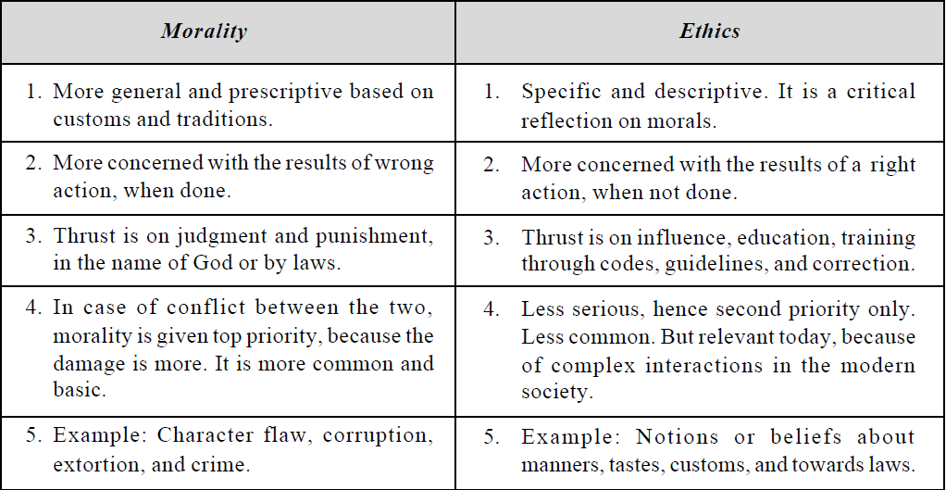
Morality Vs Ethics

Slide 12
Integrity
A term used to describe a person's level of honesty, moral commitments, and willingness to do what's right.
Show integrity to the outside world while following work ethics.

Slide 13
Academic Integrity
Five Pillars of Academic Integrity:
Honesty
Trust
Fairness
Respect
Responsibility
Notes:
The International Center for Academic Integrity (ICAI)

Slide 14
WORK ETHICS
Traditional – Work Hard
more production
Current – Work Smart
quality productivity
Individuals with strong work ethic
Will have inculcated principles that guide them in their work behavior.
Leads them to consistent higher productivity, without any prodding that many require to stay on track.

Slide 15
Importance of Work Ethic
Identify whether staff are naturally this way with strong work ethic or need be trained.
Productive Work
Cooperation
Ethics in Organizational Culture

Slide 16
Basic Work Ethic for an Organization
Uniform rules and regulations
Communication of the rules and regulation to all employees
Respect for Employees
Allow a degree of freedom to employees without constant micro-management
Clear cut salary and promotion policy
Clear and uniform holiday schedule
Effects of Work Ethics within an organization
How Leadership ethics and Employee ethics can impact the organization

Slide 17
Core ethical elements that define the ethics of an organization
A written code of ethics and standards (ethical code).
Ethics training for executives, managers, and employees.
The availability of ethical situational advice (i.e. advice lines or offices).
A confidential reporting system.

Slide 18
How to develop strong work ethic
Step 1: Be professional about your work
Reliability and honesty
Deliver best outputs
Be consistent in delivering good quality work and earn good reputation
Step 2: Manage your time
Know your strength and weaknesses
Set yourself deadlines for delivering even small tasks
Prioritize tasks and set the most important ones in the morning
Avoid negative talk and gossip

Slide 19
Continued..
Step 3: Keep a balance and deliver consistent high performance work.
Do sport, sleep well, and socialize
Step 4: Develop good work habits
Create and learn habits
“Do it now” habit
“Do it right” habit

Slide 20
Assignment
Universal Human Values
Core elements of a strong work ethic

Slide 21
SERVICE LEARNING
Service-learning refers to learning that actively involves students in a wide range of experiences, which often benefit others and the community, while also advancing the goals of a given curriculum.
It offers direct application of theoretical models.
It allows students to synthesize course material in more meaningful ways.
Common goals includes gaining;
A deeper understanding of the course/curricular content,
A broader appreciation of the discipline and
An enhanced sense of civic responsibility.

Slide 22
Qualities of service-learning
Integrative
Reflective
Contextualized
Strength-Based
Reciprocal
Lifelong

Slide 23
Benefits of Social Learning
Learning Outcomes
Personal Outcomes
Social Outcomes
Career Development
Relationship with the Institution
Faculty Benefits of Service Learning
College and University Benefits of Service Learning

Slide 24
CIVIC VIRTUE
Civic virtue is morality or a standard of righteous behavior in relationship to a citizen's involvement in society
Civic virtue is the harvesting of habits important for the success of the community.
Eg: voting, volunteering, organizing a book group, or attending a PTA meeting.
It often conceived as the dedication of citizens to the common welfare of their community even at the cost of their individual interests.

Slide 25
Continued..
The term civility refers to behavior between persons and groups that conforms to a social mode, as itself being a foundation of society and law.
Specifically what counts for civic virtue depends on the kind of political order one aspires to create.
Eg: Political Traditions.
Civic virtue is not an inherent human quality but needs to be developed.

Slide 26
RESPECT FOR OTHERS
Respect, also called esteem, is a positive feeling or action shown towards someone or something considered important, or held in high esteem or regard.
It conveys a sense of admiration for good or valuable qualities.
It is also the process of honoring someone by exhibiting care, concern, or consideration for their needs or feelings.

Slide 27
Continued..
Courtesies that show respect may include
simplewords and phrases like "Thank you" in the West or "Namaste" in the Indian subcontinent, or
simple physical signs like a slight bow, a smile, direct eye contact, or
a simple handshake;

Slide 28
How to Respect Others?
Listening to the other person.
Being empathetic, understanding each other.
Using assertive communication, that is, defending our rights while respecting the rights of others, in an educated and non-aggressive manner.
Keep in mind that our approaches, ideas, and opinions may differ from other people and none is wrong. No one has the absolute truth.
Apologizing to each other when we make mistakes.
Keeping other people’s secrets.
Complying with and respecting laws and regulations
Taking care of the common spaces and the environment.
Interest in others, their everyday life and how they feel.
Respecting the privacy and intimacy of others.
Respecting others spaces and belongings, not to invade or use what is not ours without permission.
Respect personal space.
Make sure we include rather than exclude others.
Helping others when it is in our power to do so.
Being grateful.

Slide 29
LIVING PEACEFULLY
To live peacefully, one should start install peace within (self).
Self > Family > Workspace > Society>World including environment.
You cannot gift an article which you do not possess.

Slide 30
Means to be Adopted to Live Peacefully
Order in one’s life (self-regulation, discipline, and duty).
Pure thoughts in one’s soul (loving others, blessing others, friendly, and not criticizing or hurting others by thought, word or deed).
Creativity in one’s head (useful and constructive).
Beauty in one’s heart (love, service, happiness, and peace).
Good health/body (physical strength for service).
Help the needy with head, heart, and hands (charity). Service to the poor is considered holier than the service to God.
Not hurting and torturing others either physically, verbally, or mentally.

Slide 31
Factors that Promote Peaceful Living
Conducive environment (safe, ventilated, illuminated and comfortable).
Secured job and motivated with ‘recognition and reward’.
Absence of threat or tension by pressure due to limitations of money or time.
Absence of unnecessary interference or disturbance, except as guidelines.
Healthy labour relations and family situations.
Service to the needy (physically and mentally-challenged) with love and sympathy.

Slide 32
CARING AND SHARING
Caring includes feelings, relationship, contends with other persons and protecting others and causing least damage to others.
Caring is feeling for others
It includes showing respect to the feelings of others, and also respecting and preserving the interests of all others concerned.
Caring is reflected in activities such as friendship, membership in social clubs and professional societies, and through various transactions in the family, fraternity, community, country and in international councils.
Caring of environment

Slide 33
Continued..
Sharing means sharing of feelings, ideas thoughts, resources and profits.
Sharing is always mutually beneficial.
The transfer should be genuine, legal, positive, voluntary, and without any expectation in return.
Sharing is ‘charity’ for the humanity, ‘sharing’ is a culture.
It paves the way for peace, prosperity, early and easily, and sustains it.

Slide 34
HONESTY
Honesty is speaking the truth.
Examples of what speaking the honest truth means:
Honesty means you don't say things about people that aren't true
Being honest means you admit to your actions, even if you'll get in trouble.
Honesty means you explain how a situation really happened
Being honest means you act in a way that you know is the right thing to do.

Slide 35
Continued…
Honesty is a virtue, and it is exhibited in two aspects namely,
Truthfulness
Truthfulness is to face the responsibilities upon telling truth.
Trustworthiness
Trustworthiness is maintaining integrity and taking responsibility for personal performance

Slide 36
Some of the actions of an engineer that leads to dishonesty
Lying
Deliberate deception
Withholding the information
Not seeking the truth
Not maintaining confidentiality
Giving professional judgment under the influence of extraneous factors

Slide 37
COURAGE
Courage is the tendency to accept and face risks and difficult tasks in rational ways.
Self-confidence is the basic requirement to nurture courage.
Types of Courage, based on the types of risks, namely
Physical courage ( Physical strength, including the muscle power )
Social courage (Leadership abilities )
Intellectual courage (Empathy and Sacrifice)

Slide 38
Continued..
One should perform Strengths, Weakness, Opportunities, and Threat (SWOT) analysis.
Expressions of Courage
Facing the criticism, owning responsibility, and accepting the mistakes or errors when committed and exposed are the
Characteristics of courageous people
Perseverance (sustained hard work),
Experimentation (preparedness to face the challenges, that is, unexpected or unintended results),
Involvement (attitude, clear and firm resolve to act), and
Commitment (willing to get into action and to reach the desired goals by any alternative but ethical means).

Slide 39
COOPERATION
It is a team-spirit present with every individual
Cooperation is activity between two persons or sectors that aims at integration of operations (synergy), while not sacrificing the autonomy of either party
Cooperation promotes collinearity, coherence (blend), co-ordination and the synergy.
The absence of cooperation leads to lack of communication, misinformation, and undue delay between supply, production, marketing, and consumption.
Notes:
Synergy -

Slide 40
Continued..
The impediments to successful cooperation are:
Clash of ego of individuals.
Lack of leadership and motivation.
Conflicts of interests, based on region, religion, language, and caste.
Ignorance and lack of interest.
By careful planning, motivation, leadership, fostering and rewarding team work, professionalism and humanism beyond the ‘divides‘, training on appreciation to different cultures, mutual understanding ‘cooperation‘ can be developed and also sustained.

Slide 41
COMMITMENT
Commitment means acceptance of the responsibilities and duties
Commitment means alignment to goals and adherence to ethical principles during the activities.
Work teams that are committed and cooperative are more likely to achieve the goals the business has set.
Commitment helps :
Maintaining or increasing quality
Reaching or exceeding production targets
Decreasing complaints from team members
Limited conflict between team members
Fewer workplace injuries.

Slide 42
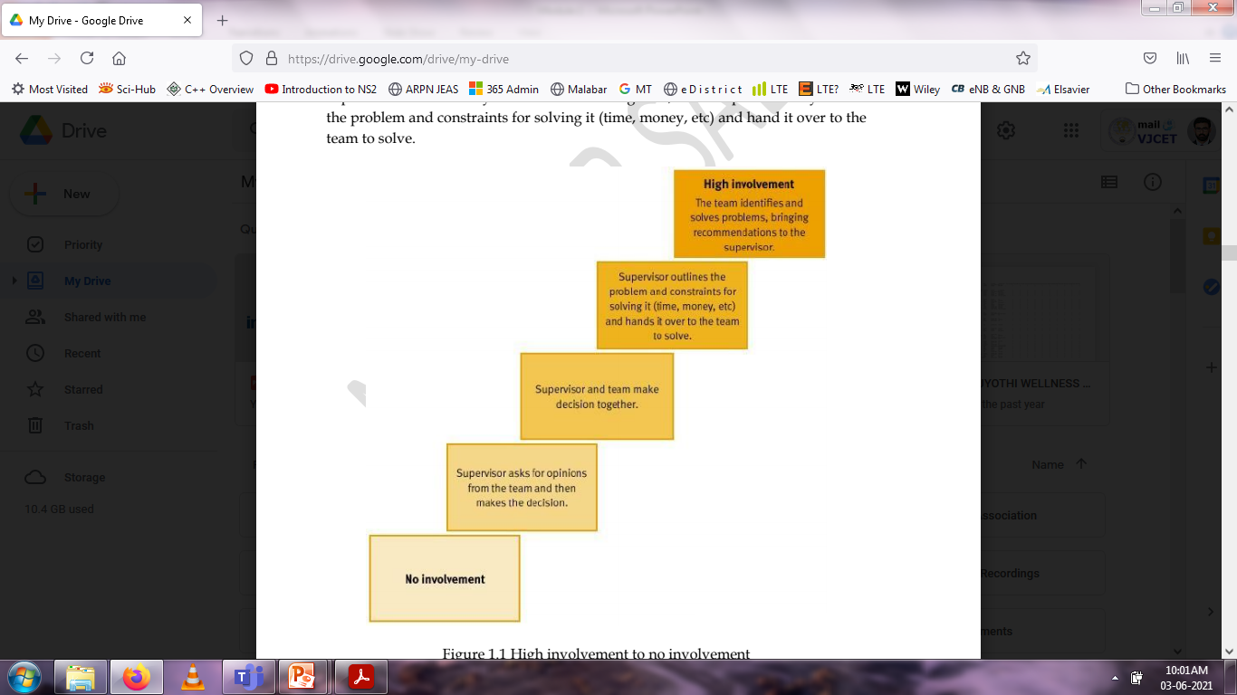
Degrees of Team Involvement in Decision Making

Slide 43
EMPATHY
Sensing what others feel about, without their open talk, is the essence of empathy.
Empathy begins with showing concern, and then obtaining and understanding the feelings of others, from others‘ point of view
The benefits of empathy includes:
Good customer relations
Harmonious labour relations
Good vendor-producer relationship

Slide 44
Continued..
Characteristics need to be developed by a good leader to practice empathy
Understanding others
Service orientation
Developing others
Leveraging diversity
Political awareness

Slide 45
SELF-CONFIDENCE
Certainty in one‘s own capabilities, values, and goals, is self-confidence.
Self-confidence is positive attitude, wherein the individual has some positive and realistic view of himself, with respect to the situations in which one gets involved.
The people with self- confidence exhibit courage to get into action and unshakable faith in their abilities, whatever may be their positions
The self-confidence in a person develops a sense of partnership, respect, and accountability
Helps the organization to obtain maximum ideas, efforts, and guidelines from its employees.

Slide 46
Continued..
The people with self-confidence have the following characteristics:
A self-assured standing,
Willing to listen to learn from others and adopt (flexibility),
Frank to speak the truth, and
Respect others’ efforts and give due credit.
The factors that shape self-confidence in a person
Heredity (attitudes of parents) and family environment,
Friendship (influence of friends/colleagues),
Influence of superiors/role models, and
Training in the organization

Slide 47
Continued..
The following methodologies are effective in developing self-confidence in a person:
Encouraging SWOT analysis. By evaluating their strength and weakness, they can anticipate and be prepared to face the results.
Training to evaluate risks and face them (self-acceptance).
Self-talk . It is conditioning the mind for preparing the self to act, without any doubt on his capabilities. This make one accepts himself while still striving for improvement.
Study and group discussion, on the history of leaders and innovators

Slide 48
SOCIAL EXPECTATIONS
Social expectations are ideas that we have of how someone in our social surroundings will behave in the future or in a specific situation.
This helps us imagine how we have to behave or act around them and to predict their behaviour.

